Slide 1
Unsupervised speaker adaptation using limited data
Aman Ranjan Verma |15010212 | 4th Year Project

Slide 2
Week - 1
Revised concepts from DSP.
Reading Getting started with Speech Processing from S K Das Mandal (IIT Madras), NPTEL Course.
Reading Unsupervised Learning concept of Machine Learning from online platform “Coursera”.
Hunting for recourses on the topic from seniors and online.

Slide 3
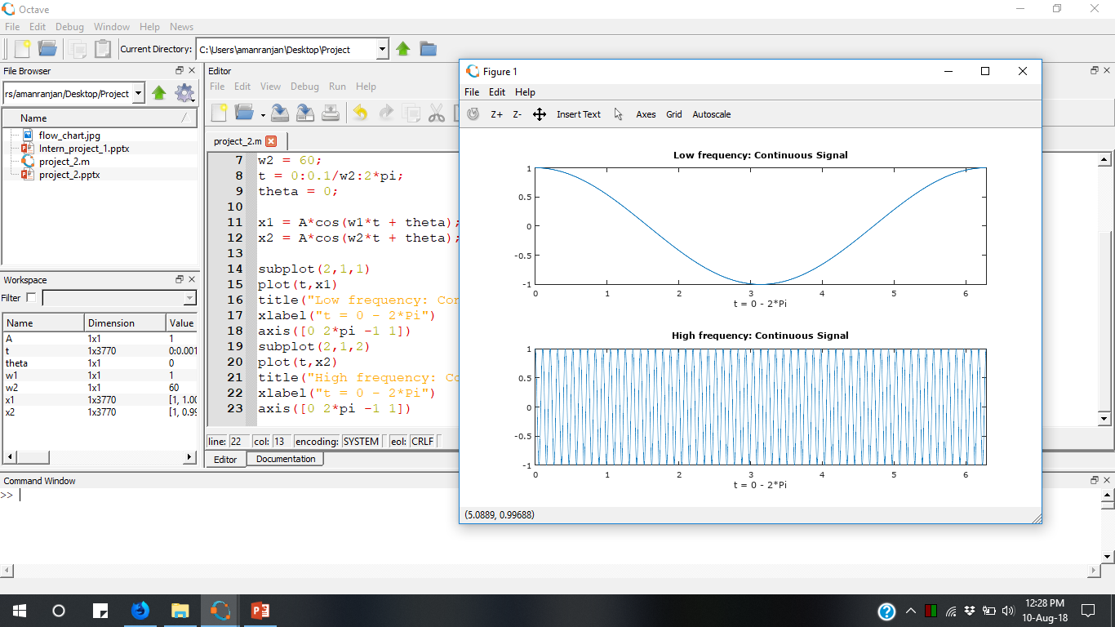
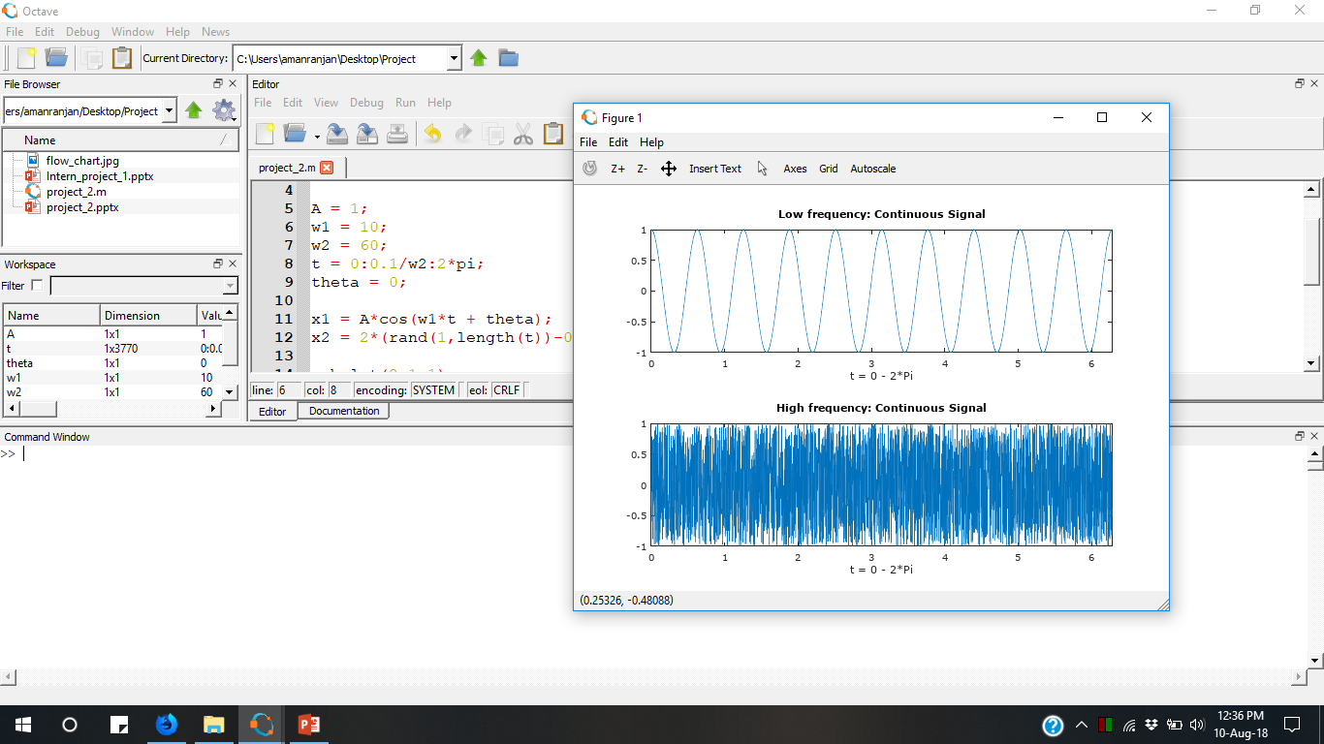
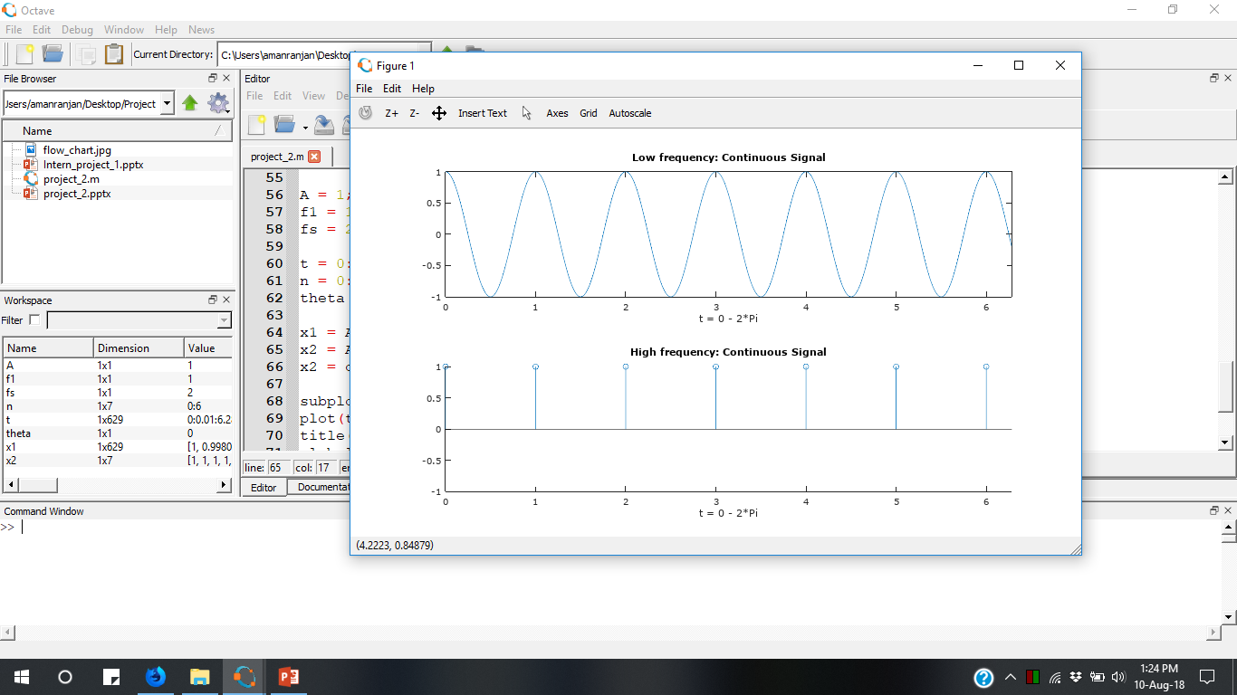
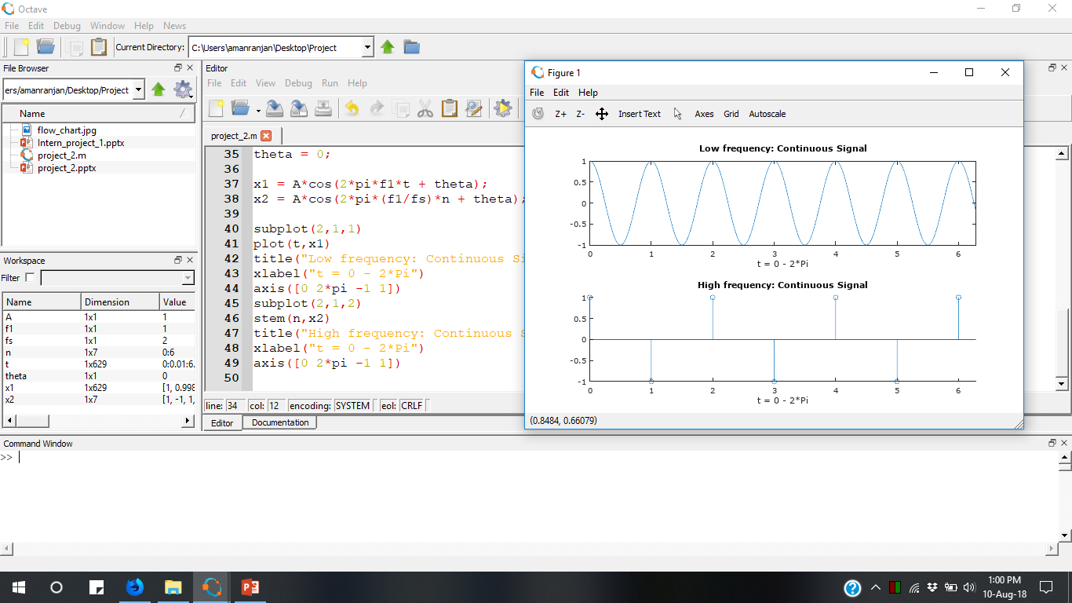
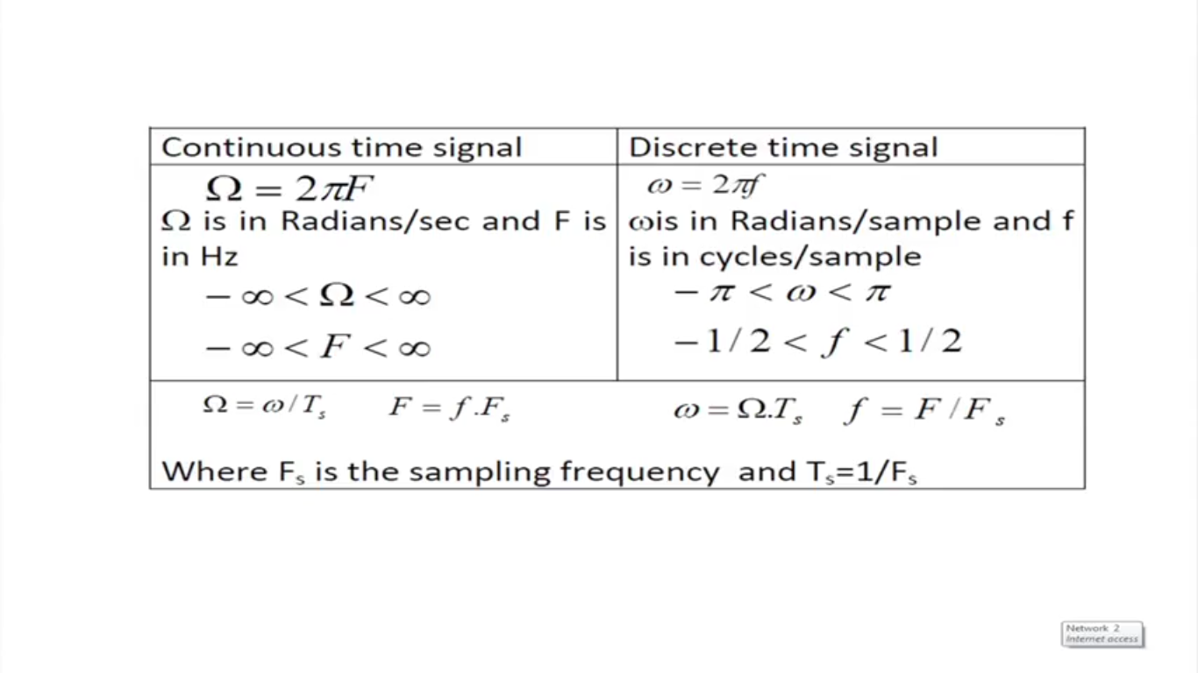
DSP Concepts
Continuous time and Discrete time Signal
Periodic and Non Periodic signal (x[n+N] = x[n])
High Frequency and Low frequency Signal
Impulse Function
Classification of Discrete time Signal
Energy and Power Signal.
Symmetric and antisymmetric signal (x[n] = x[-n])
Stationary & Non stationary Signal
Speech is non stationary signal.
signal statistics minimum, maximum, mean, variance and peak-to-RMS and the signal power spectrum density.

Slide 4
System Concept
Static and Dynamic System
Static : y(t) = f(t)
Dynamic: y(t) = f( t, t-1,t+1 )
Time Variant and Time invariant system
Vocal cord is time variant system
Y(x) = x^2 + 3*x +5 , is a time invariant system.
Linear and Non linear system
H[ f1(x) + f2(x) ] = H [ f1(x) ] + H[ f2(x) ] : Linear System
LTI System
Linear + Time invariant

Slide 5
System Concept
Causal & Non Causal System
Y(x) = f( x, x-k ) : Causal
Stable and Unstable
BIBO, sin(t) : Stable
Log(t) : Unstable
Recursive and Non Recursive System
Y(t) = f(y(t-1)) : Recursive
Convolution
Linear and Circular convolution(periodic signal)
Input
Convolutional Neural Network
Output

Slide 6
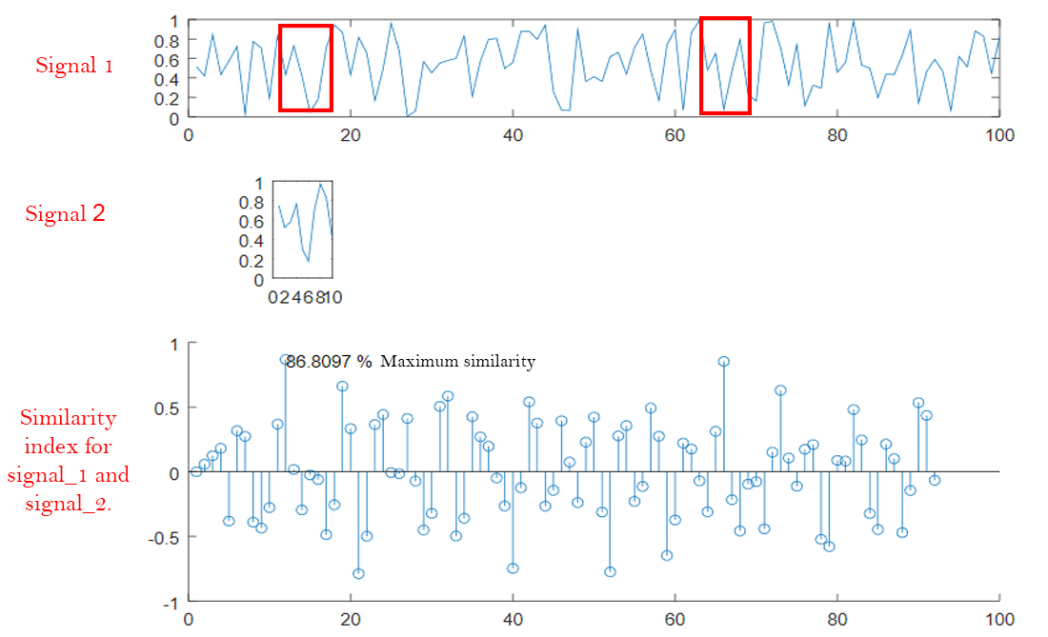
Correlation
Cross correlation and Auto Correlation

Slide 7
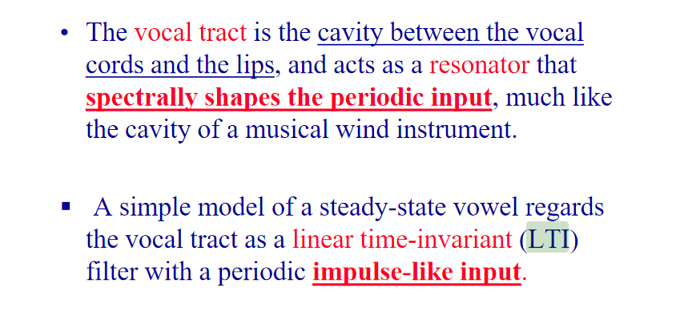
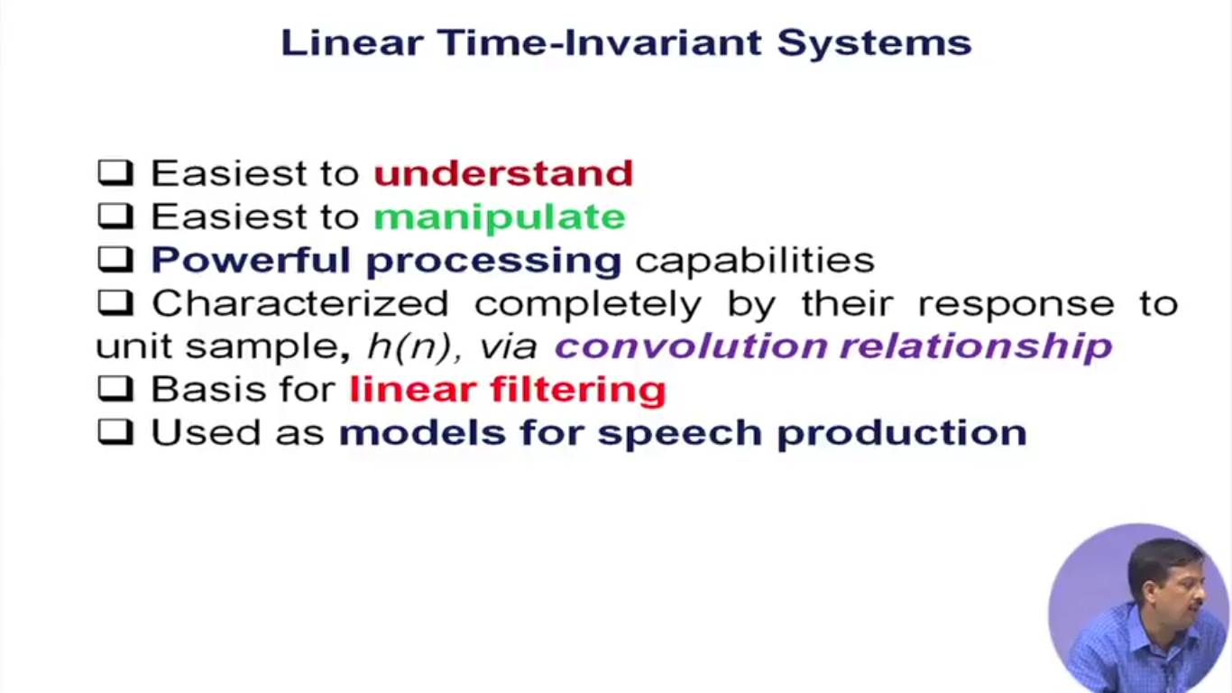
LTI : Linear Time Invariant

Slide 8
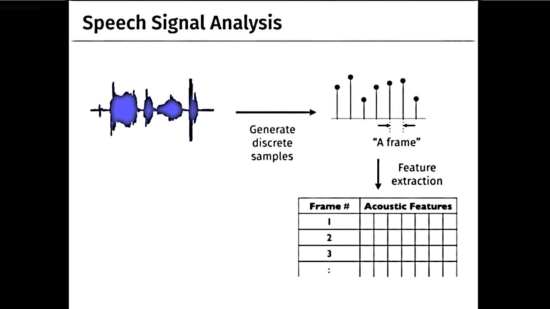
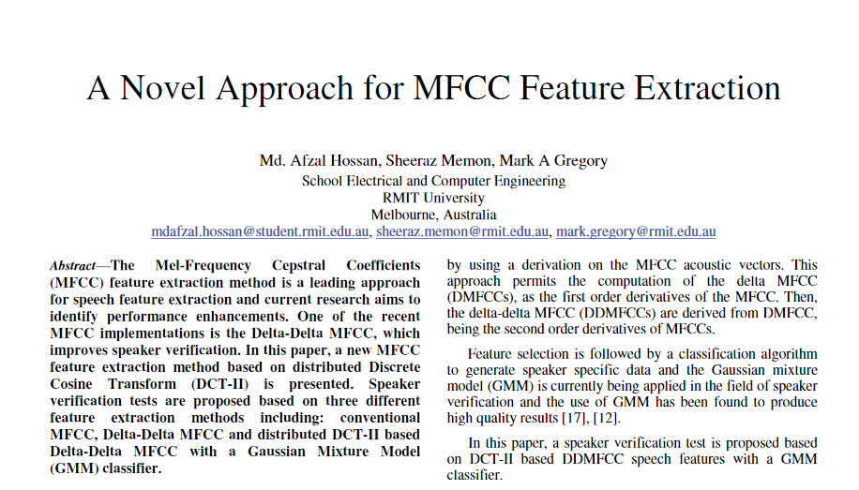
Feature Extraction
One of the common way of representing acoustic feature is MFCC.
MFCC : Mel-Frequency Cepstral Coefficients
Still reading, source: IEEE

Slide 9
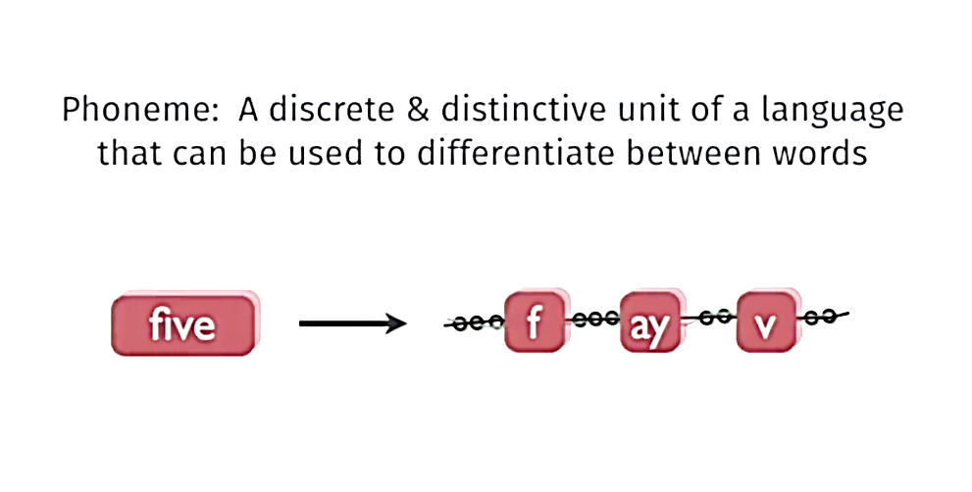
Basic Unit of Acoustic Information

Slide 10
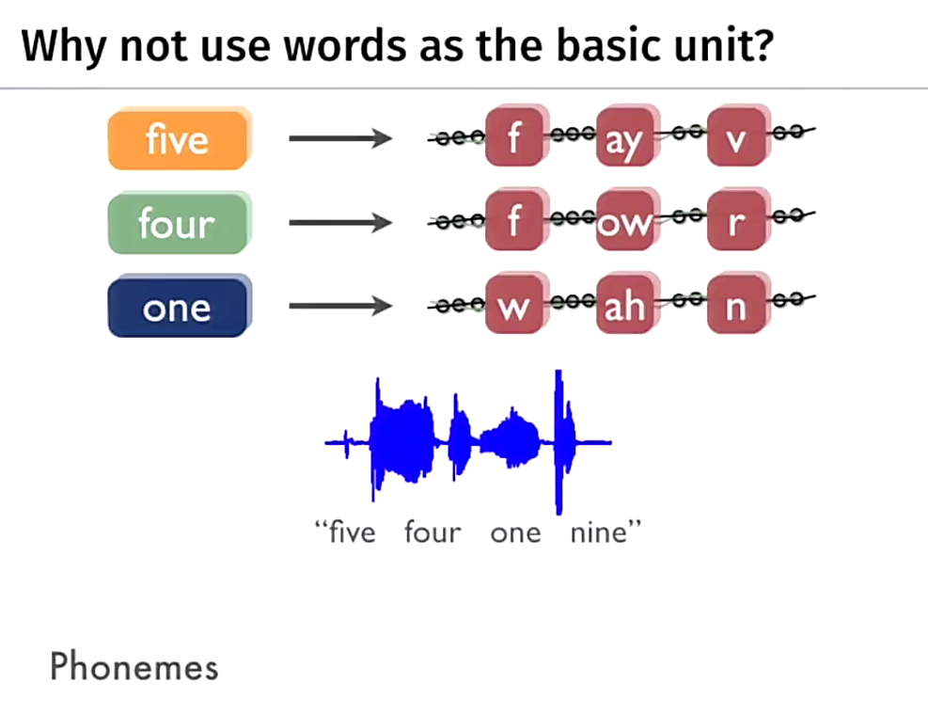

Slide 11
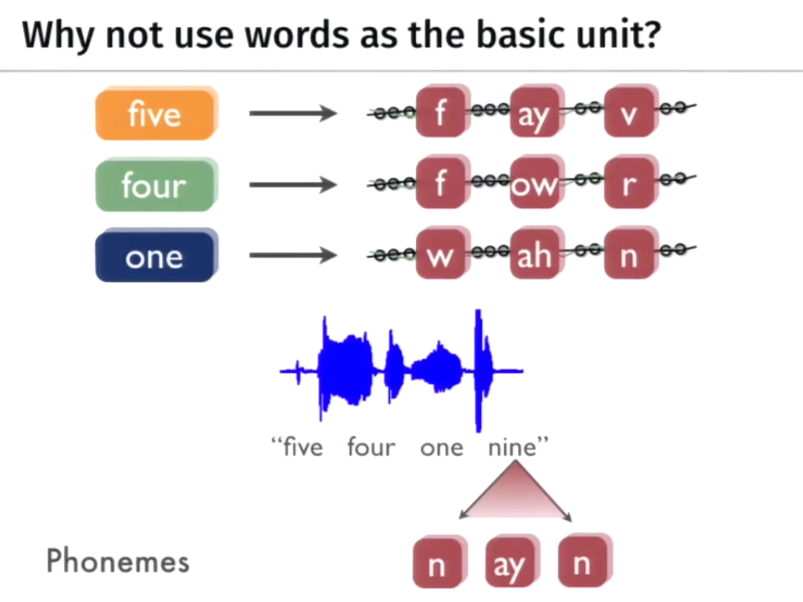

Slide 12
Why not phonemes?
Word level model is sufficient.
Dictionary
Predefined phrases to be spoken

Slide 13
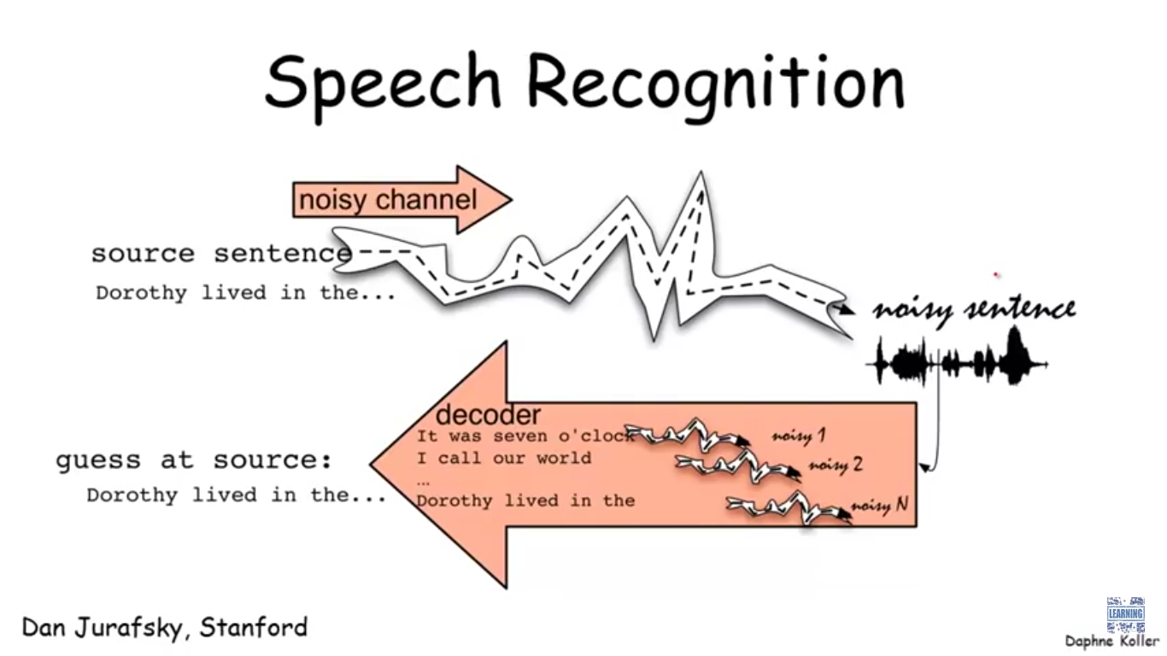

Slide 14
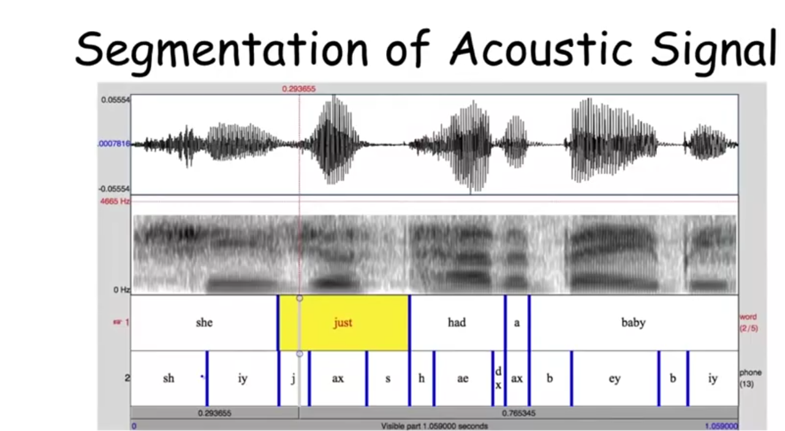

Slide 15
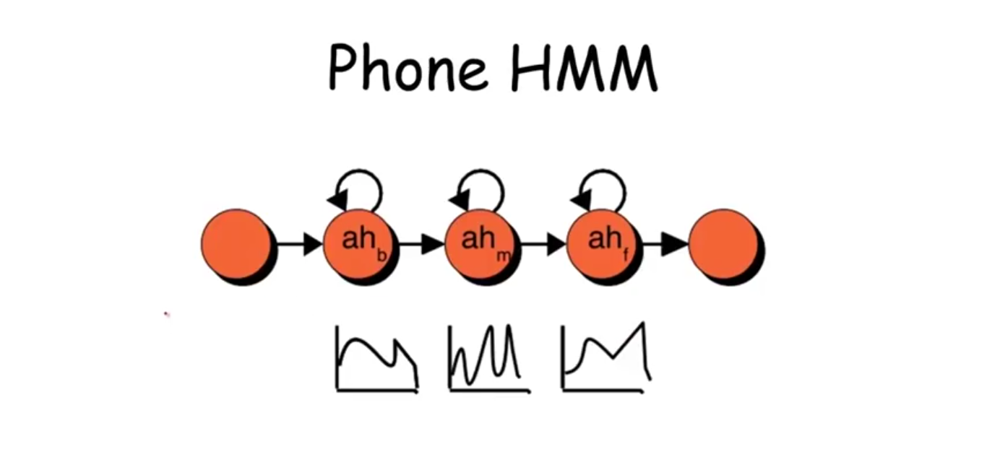

Slide 16
Why not HMM?
Because HMM is a data hungry process.
It works on phonemes level, where as our work can be done on word level modeling.
Neural Network is one process which can do the same with limited data.

